Slide 1
最大期望算法 EM algorithm
Tristan Dobos, Killian Laturelle, Rémi Soave

Slide 2
Introduction
This presentation explores the Expectation-Maximization (EM) algorithm, an iterative statistical method used to estimate parameters in probabilistic models, particularly when data is incomplete or involves hidden variables.

Slide 3
Introduction
What is the Expectation-Maximization Algorithm (EM)?
Iterative statistical algorithm for parameter estimation in probabilistic models.
Effective with incomplete data or hidden variables.
Maximizes likelihood despite missing information.
Commonly used in clustering (Gaussian Mixture Models) and Hidden Markov Models.

Slide 4
Motivation for the EM Algorithm
Why Do We Need the EM Algorithm?
Real-world data is often incomplete.
Challenges in parameter computation without true labels.
Direct maximization of likelihood is complex or impossible.
EM algorithm provides a structured, iterative approach.
Estimates latent variables and adjusts model parameters iteratively.

Slide 5
Structure of the EM Algorithm
The Two Key Steps of the EM Algorithm
Expectation Step (E-step): estimate hidden data values based on current parameters.
Maximization Step (M-step): update parameters to maximize likelihood with new estimates.
Process continues until convergence with no significant parameter change.

Slide 6
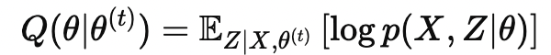
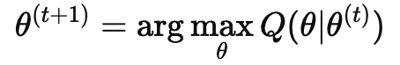
Formal Steps of the EM Algorithm
1. E-STEP - Expectation Step :
In this step, the algorithm computes the expected value of the log-likelihood function, with respect to the conditional distribution of the hidden variables given the observed data and the current estimates of the parameters. The idea is to estimate the missing data or latent variables based on the observed data and the current model parameters.
2. M-STEP - Maximization Step :
In this step, the algorithm updates the parameters by maximizing the expected log-likelihood obtained in the E-step. The goal here is to find the parameters that maximize the expected likelihood calculated in the E-step.
3. Convergence: We repeat the E-step and M-step until the parameters stabilize, meaning the difference between parameter values from one iteration to the next becomes very small. This is when we say the algorithm has converged.

Slide 7
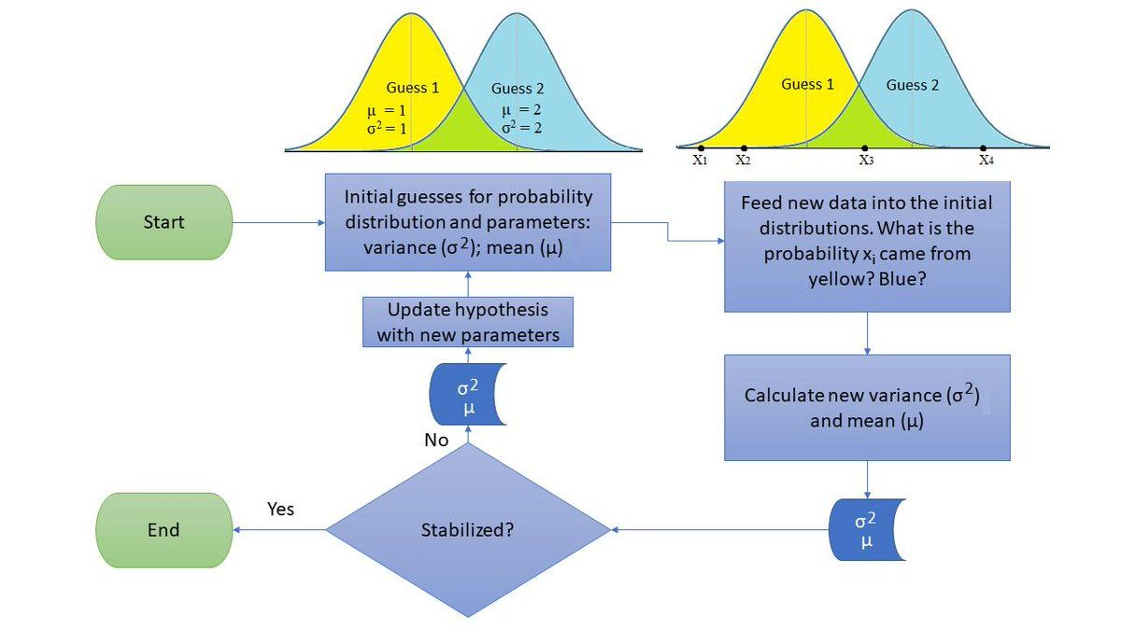
Schema

Slide 8
The execution
Iterative Process:
Initialize the model parameters θ⁽⁰⁾
Repeat until convergence:
E-step: Calculate the expected log-likelihood using current parameters.
M-step: Update the parameters by maximizing the expected log-likelihood.

Slide 9

First example

Slide 10
What is GMM?
A Gaussian Mixture Model (GMM) is a probabilistic model used to represent a mixture of multiple Gaussian distributions. It is primarily used for clustering and density estimation. A GMM assumes that data points are generated from a mixture of several Gaussian distributions, each with its own mean and covariance.
Key components of a GMM:
Gaussian components: Each component in the mixture is a Gaussian (normal) distribution, characterized by:
Mean (μ) - the center of the distribution
Covariance (Σ) - the spread and orientation of the distribution
Mixture weights: Each Gaussian has an associated weight (π) that represents the proportion of data points generated by that Gaussian.

Slide 11
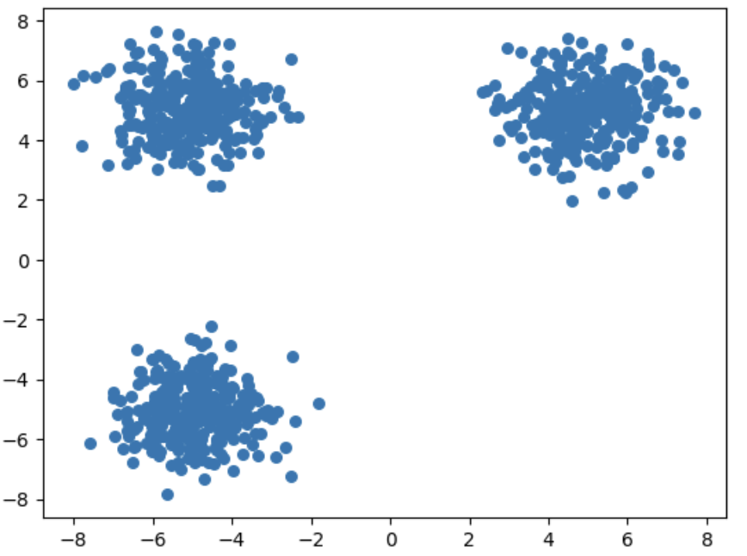
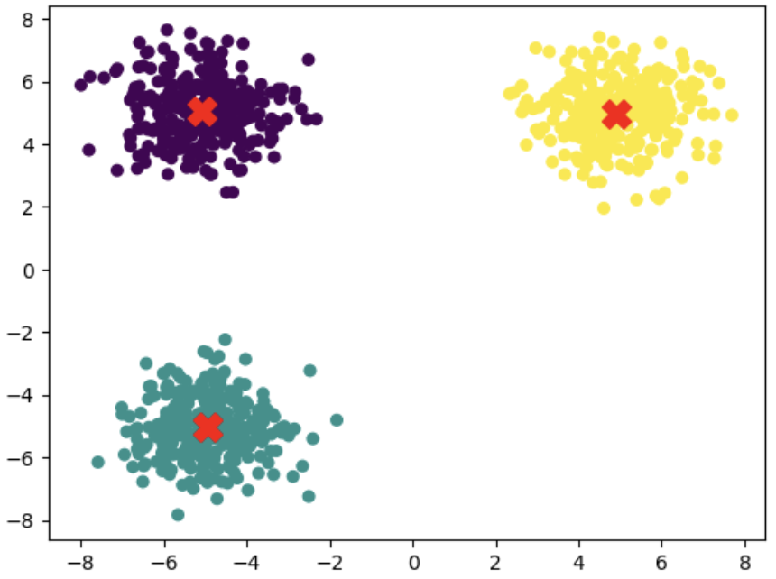
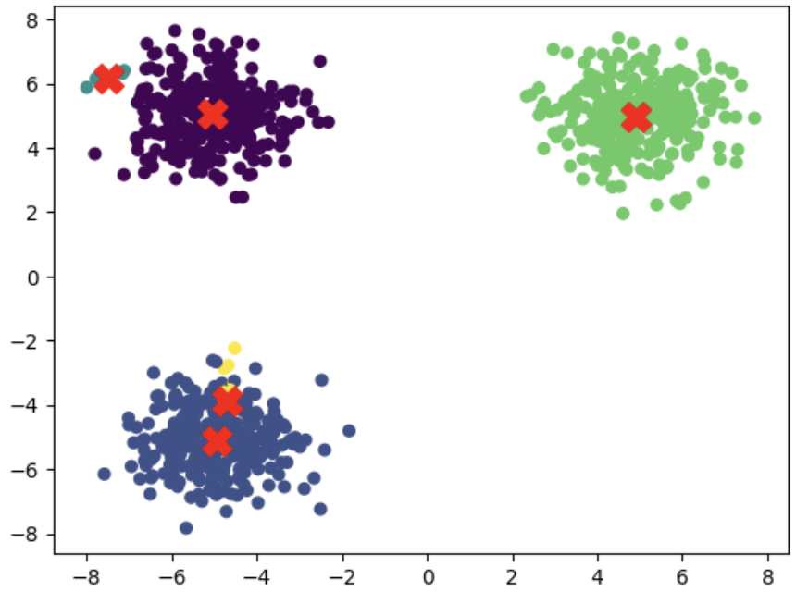
The execution - easy example

Slide 12
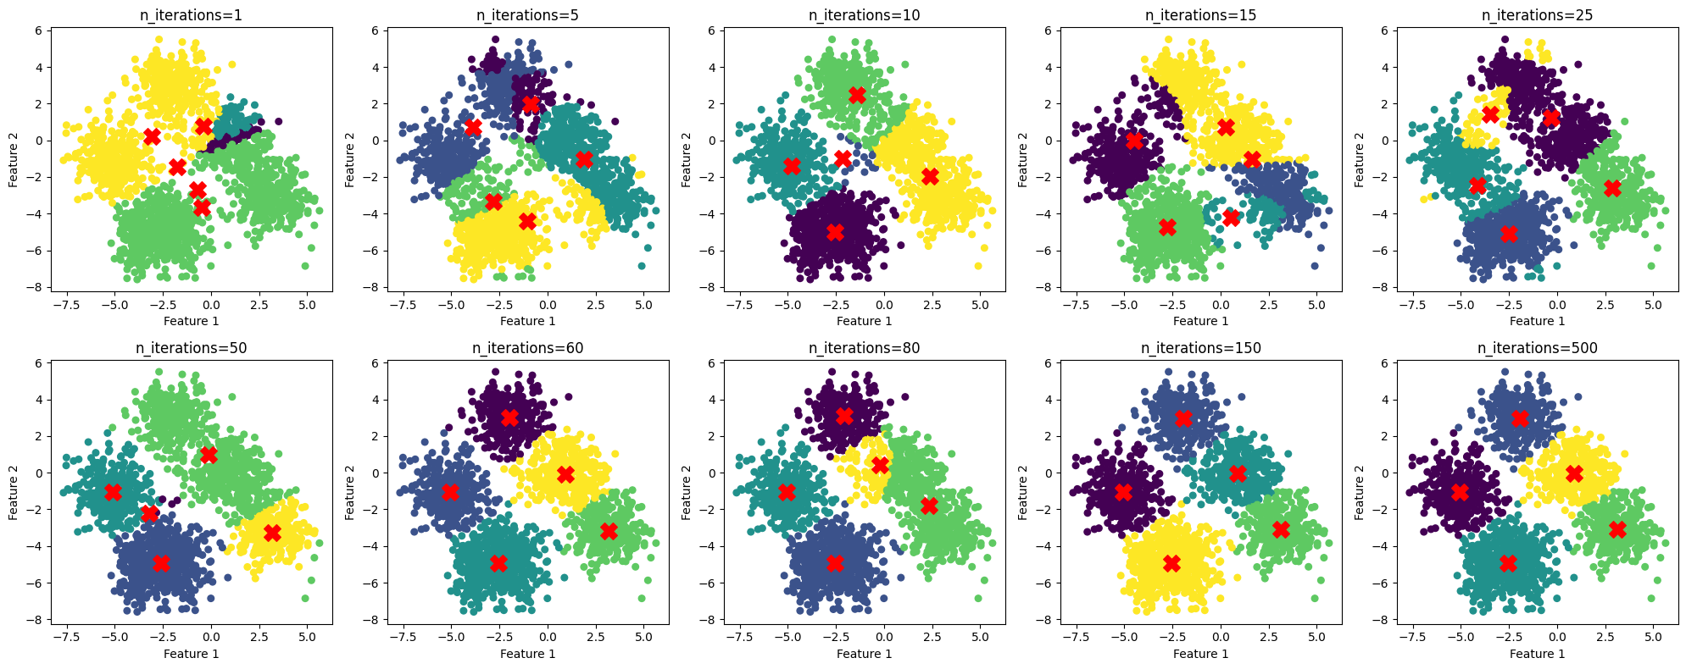
Converging to the final classification

Slide 13
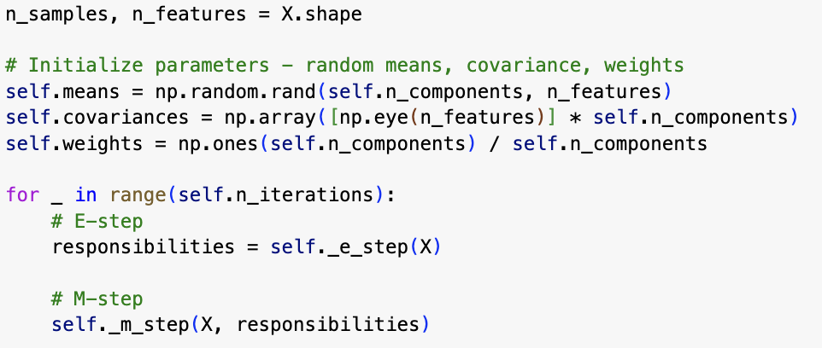
code: source

Slide 14
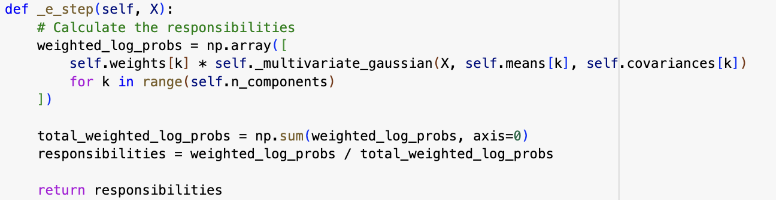
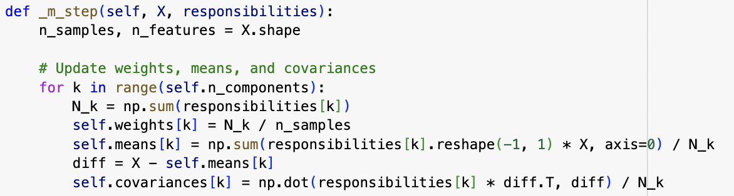
E-step
calculate the probabilities
M-step
update the parameters
code: source

Slide 15

First example

Slide 16
HMM and Vitebri algorithm explanation
A Hidden Markov Model (HMM) is a statistical model used to represent systems that have hidden states which can be inferred through observable events. In an HMM, we have:
States: These represent the possible conditions or positions of the system, which are hidden and not directly observable.
Observations: These are the observable events or signals influenced by the hidden states.
Transition Probabilities: These define the probabilities of moving from one hidden state to another.
Emission Probabilities: These are the probabilities of an observable event occurring given a hidden state.
Initial Probabilities: These define the probability of starting in each state.
The Viterbi Algorithm is a dynamic programming algorithm used to find the most likely sequence of hidden states (the "best path") that results in a given sequence of observed events. It is often used for decoding the hidden state sequence in HMMs. The algorithm works by:
Initialization: It sets the starting probabilities for all possible initial states.
Recursion: It calculates the most probable path to each state at each time step by considering the transition probabilities from previous states and the emission probabilities for the current observation.
Termination: It selects the state sequence with the highest probability as the final solution.
Backtracking: This step helps to recover the optimal sequence of hidden states by tracing back from the most probable end state.

Slide 17
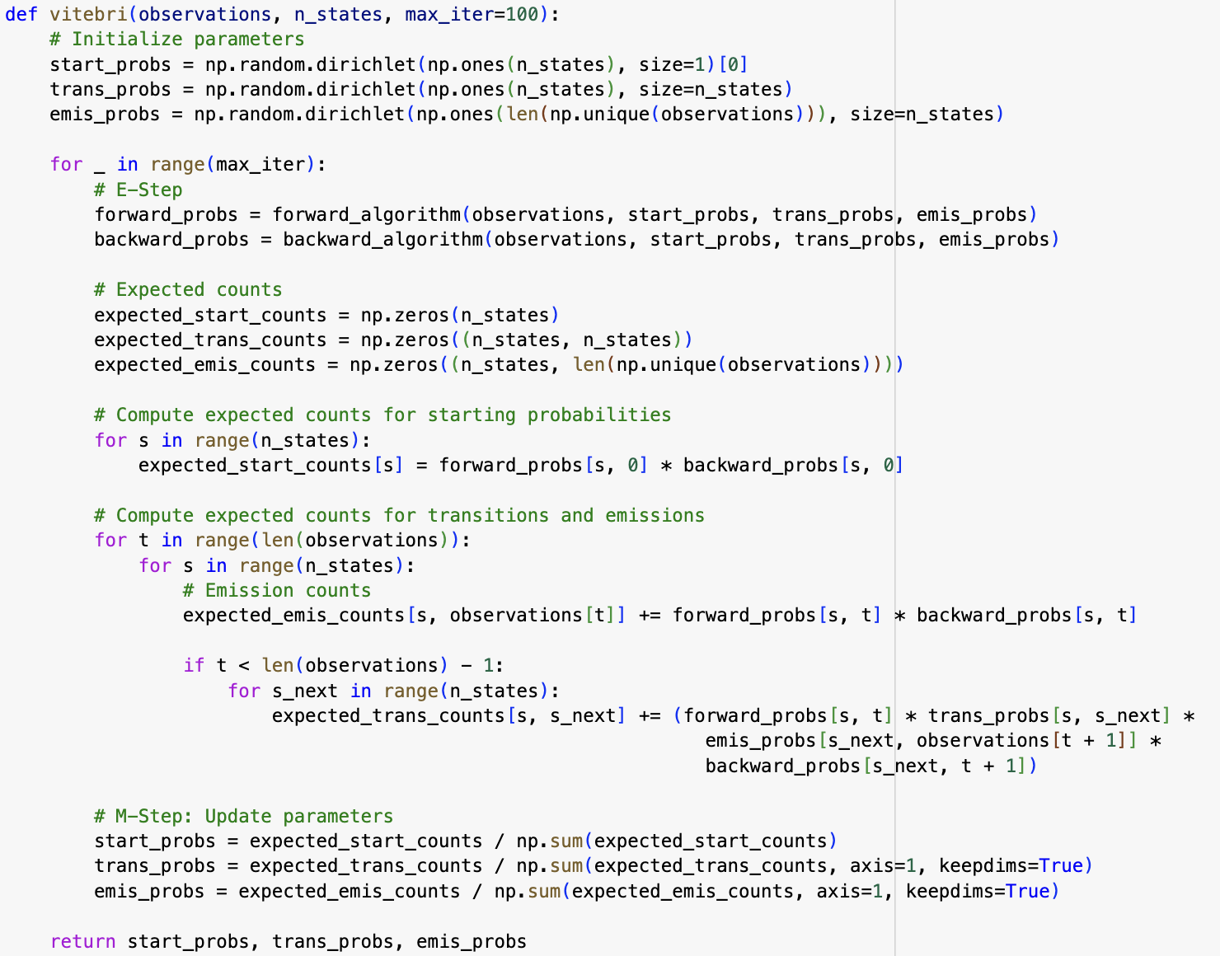
The execution
E-step
calculate the probabilities
M-step
update the parameters
code: source

Slide 18
First example
Convergence
(why this works)

Slide 19
Proof of convergence
This algorithm is not guaranteed to converge to global maximum, however, it has the important property that the likelihood is guaranteed to increase at each iteration:
p(x|θ_{j}) ≥ p(x|θ_{j-1})
because
ln[p(x|θ_{j})] ≥ ln[p(x|θ_{j-1})]
or
ln[p(x|θ_{j})] - ln[p(x|θ_{j-1})] ≥ 0
full proof: here

Slide 20
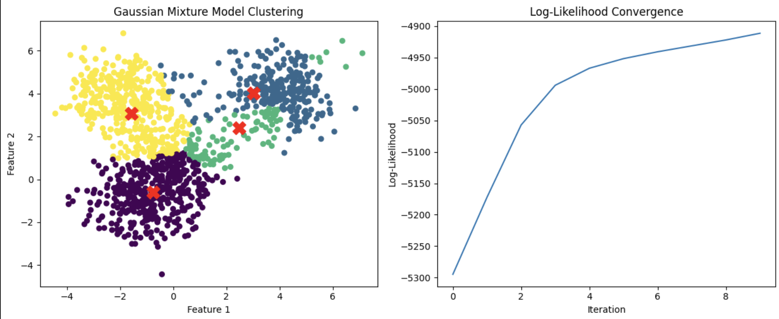
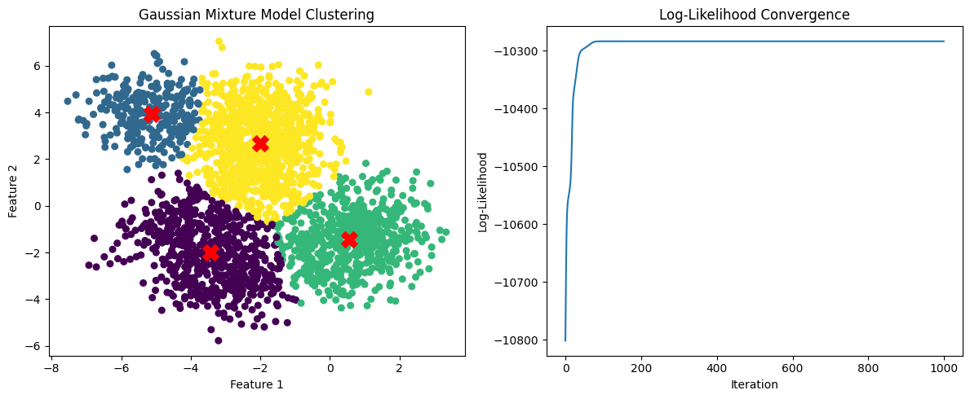

Proof of convergence
after 10 iterations
after 1000 iterations
after 100 iterations

Slide 21
First example
Other examples

Slide 22
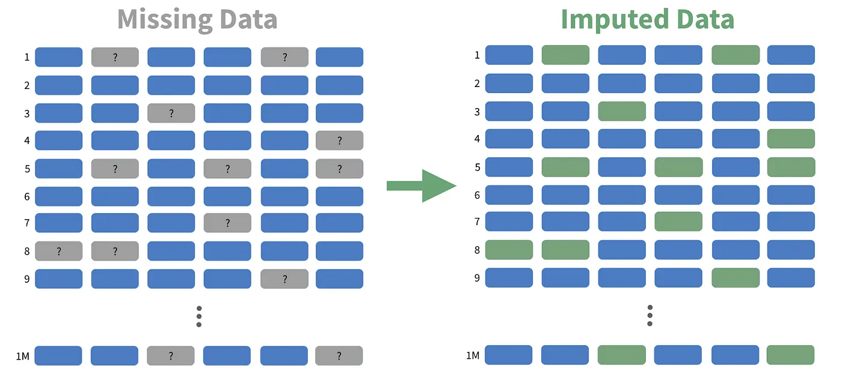
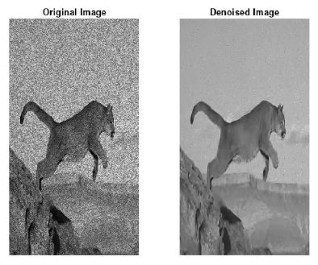
Other examples of the use of EM
1. Missing Data Imputation:
EM can be used to handle datasets with missing or incomplete data. In the E-step, the missing data is "guessed" based on the observed data, and in the M-step, the parameters of the model are updated to maximize the likelihood of the complete data (both observed and imputed). The process iterates until the likelihood converges.
2. Image Denoising (Segmentation):
In image denoising, EM is used to estimate the true pixel values of an image that has been corrupted by noise. In the E-step, the missing or noisy values are inferred based on the current parameters, and in the M-step, the parameters (like pixel intensities or noise variances) are optimized to fit the observed image data, reducing the noise iteratively.

Slide 23
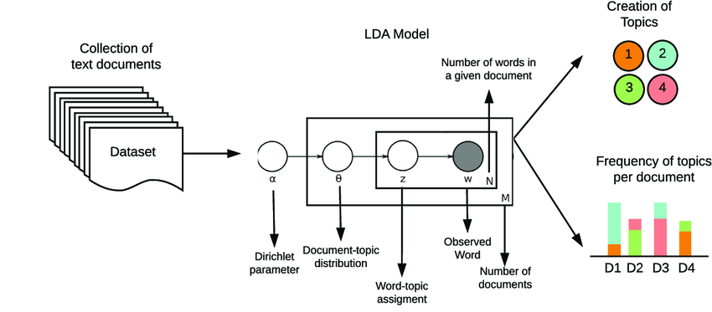
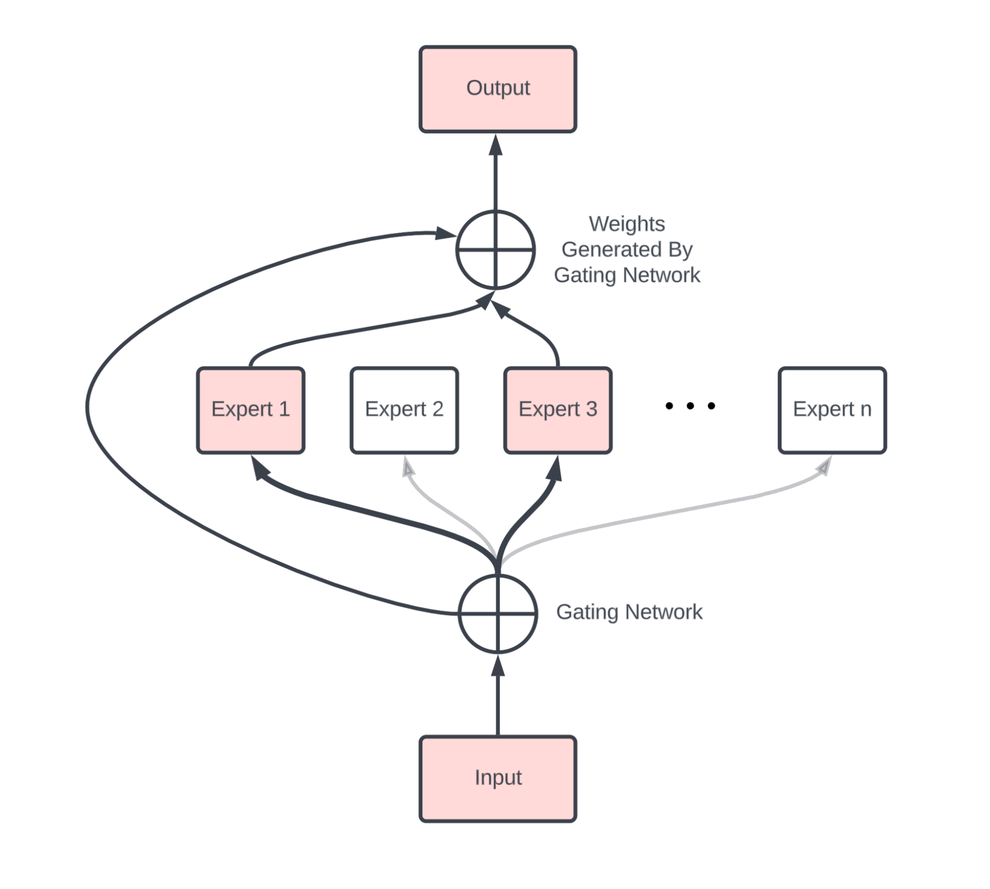
Other examples of the use of EM
Missing Data Imputation:
EM can be used to handle datasets with missing or incomplete data. In the E-step, the missing data is "guessed" based on the observed data, and in the M-step, the parameters of the model are updated to maximize the likelihood of the complete data (both observed and imputed). The process iterates until the likelihood converges.
Image Denoising (Segmentation):
In image denoising, EM is used to estimate the true pixel values of an image that has been corrupted by noise. In the E-step, the missing or noisy values are inferred based on the current parameters, and in the M-step, the parameters (like pixel intensities or noise variances) are optimized to fit the observed image data, reducing the noise iteratively.
3. Document Clustering (Latent Dirichlet Allocation - LDA):
EM is used in LDA for topic modeling, where the goal is to discover the hidden topics in a set of documents. In the E-step, the algorithm estimates the probabilities of each document belonging to various topics (latent variables), and in the M-step, the topic distributions are updated to maximize the likelihood of the data given the current topic assignment.
4. Mixture of Experts Model:
EM is applied in Mixture of Experts, where several models (experts) are combined to make predictions. Each expert is responsible for a portion of the input space, and EM helps determine the probability of each expert being responsible for a particular data point (E-step), and updates the expert models' parameters to maximize predictive accuracy (M-step). This is useful for tasks where different models might be better suited to different regions of the data.

Slide 24
EM Algorithm - Pros And Cons
Pros | Cons
Missing Datas Handling | Stagnation in Local Maxima
Maximum Likelihood Convergence | Slow Convergence
Extended Spectrum of Use | High Sensibility to Initial Conditions
Easy Implementation | Model Choice Related Problems

Slide 25
EM Algorithm - Variations
Stochastic EM Algorithm
Generalized EM Algorithm
Classification EM Algorithm

Slide 26
EM Algorithm - Stochastic
Some clarifications :
Use of stochastic approximation of the value fully calculated in the E-step, then distribution is set randomly giving a multinomial distribution.
What it means :
Computational costs greatly reduced, works well with especially large datasets.

Slide 27
EM Algortihm - Generalized
Some clarifications :
M-Step :
Random θ initialization
t = 0
While the algorithm has not converged, choose θ^{(t+1)} as Q(θ^{(t+1)}, θ^{(t)}) > Q(θ^{(t)}, θ^{(t)})
t = t + 1
What it means :
Q maximisation is not needed, only improved each time the algorithm did not converged

Slide 28

EM Algorithm - Classification
Some clarifications :
A new step is placed between the E and M steps. After computing probabilities, CEM makes a hard classification decision by assigning each data point to the class with the highest probability.
What it means :
Unlike classic EM, we optimize the likelihood given by :

Slide 29
EM Algorithm - Room for Improvement
Speed : Slow convergence, especially near the optimum.
CEM, but more likely to get stuck
Costability : High cost, especially for the large data sets
GEM or SEM, but slower
Flexibility : Assumes that missing data is random.
Directly work on data model
Local optima : Stick randomly to local optima.
Stochastic, but optimized tuning is expected.

Slide 30
Thank you!
谢谢!

